Slide 1
CONFERENCING
WITH FLEET
NODE
Reel time communication made Real

Slide 2
...and our sets of editable icons
You can resize these icons without losing quality.
You can change the stroke and fill color; just select the icon and click on the paint bucket/pen.
In Google Slides, you can also use Flaticon’s extension, allowing you to customize and add even more icons.

Slide 3
TABLE OF CONTENTS
01
06
About the Project
Major Requirements
02
07
Idea – Context and Objective
Design - Project Stages
03
08
Project Term Definition
Architecture
Here we describe
About the project
Here we describe the
User Requirements
Here we describe the
Ideas and Objectives
Here we describe the
Project Design
Here we describe terms
Used in project
Here we describe the
Architecture of the page
04
09
Difficulties
Screenshot
Here we describe the difficulties
Faced by users without fleet
Here we describe
web wire Framings
05
10
Tech Stack
Completion Status
Here we describe the
Tech Stack used in the Project
Here we describe the
Completion status

Slide 4

ABOUT PROJECT
FLEET
Fleet is designed in order to give quality conferencing to people in urban and rural area with variety of scopes.
In today’s times where the pandemic has changed the way people even breathe it is necessary for the video conferencing service.

Slide 5
IDEA
Video Conferencing
Privacy in Communication
User Freindly

Slide 6
IDEA
Context:
-Video calls have become an integral part of today's communication.
-Only in the first four months of the COVID-19 pandemic was a 500% increase in search impressions for web and video conferencing software.
-And video chat apps continue growing in popularity with incredible speed both for businesses and personal use.
Objective:
-To build a video conferencing web app enabling users to have interactions over the internet.
-To implement the new industry standard for video conferencing i.e Webrt.
-To make a user base and identify different users on network.
-Allow sharing of messages during the video conferencing.
-To aid teaching with the help of whiteboard.

Slide 7
Key Features:
1. Hassle free google authentication
2. Fast streaming due to P2P architecture
3. Unique codes for meetings making easy to manage
4. Whiteboard streaming
5. Screen Sharing
6. Conference History Records

Slide 8
SOME PROJECT DEFINITION
WEBRTC
SOCKET.IO
NAVIGATOR-media devices
WebRTC (Web Real-Time Communication) is a technology that enables Web applications and sites to capture and optionally stream audio and/or video media, as well as to exchange arbitrary data between browsers without requiring an intermediary.
Socket.IO is a library that enables real-time, bidirectional and event-based communication between the browser and the server.
The Media Devices interface provides access to connected media input devices like cameras and microphones, as well as screen sharing. In essence, it lets you obtain access to any hardware source of media data.

Slide 9
WHAT WE ARE WORKING ON
SECURE
ACCESSIBLE
FAST AND RELIABLE
Mercury is the closest planet to the Sun
Despite being red, Mars is a cold place, not hot
Neptune is the farthest planet from the Sun

Slide 10
ABOUT THE PROJECT
Mercury is the closest planet to the Sun and the smallest one in the Solar System—it’s only a bit larger than our Moon. The planet’s name has nothing to do with the liquid metal since it was named after the Roman messenger god, Mercury

Slide 11
MAJOR REQUIREMENTS
IMAGES
USER EXPERIENCE
INFORMATION
Despite being red, Mars is a cold place, not hot. It’s full of iron oxide dust
Venus has a beautiful name and is the second planet from the Sun
Mercury is the closest planet to the Sun and the smallest in our Solar System

Slide 12
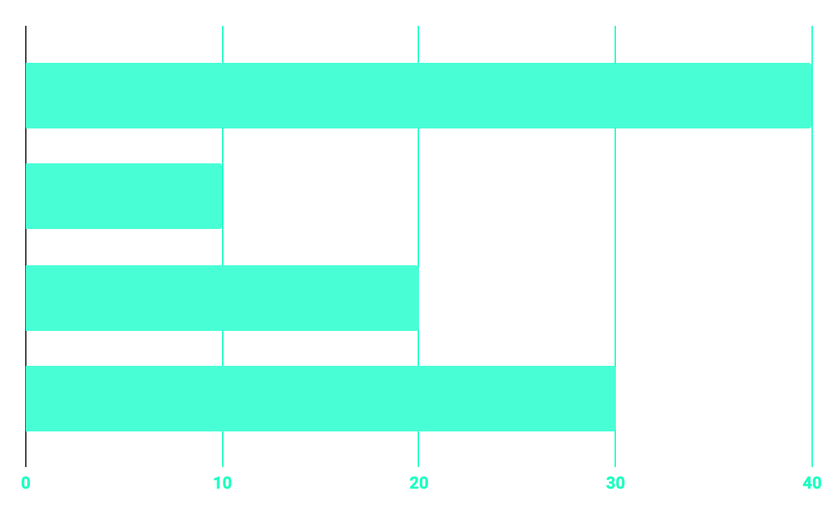
BUDGET
40%
20%
PROGRAMMING
10%
30%
DATABASE
WEB DESIGN
UX RESEARCH

Slide 13
OUR GOALS
EXPANSION
POSITIONING
USABILITY
Neptune is the fourth-largest planet in our Solar System
Venus has a beautiful name and is the second planet from the Sun
Despite being red, Mars is a cold place, not hot. It’s full of iron oxide dust

Slide 14
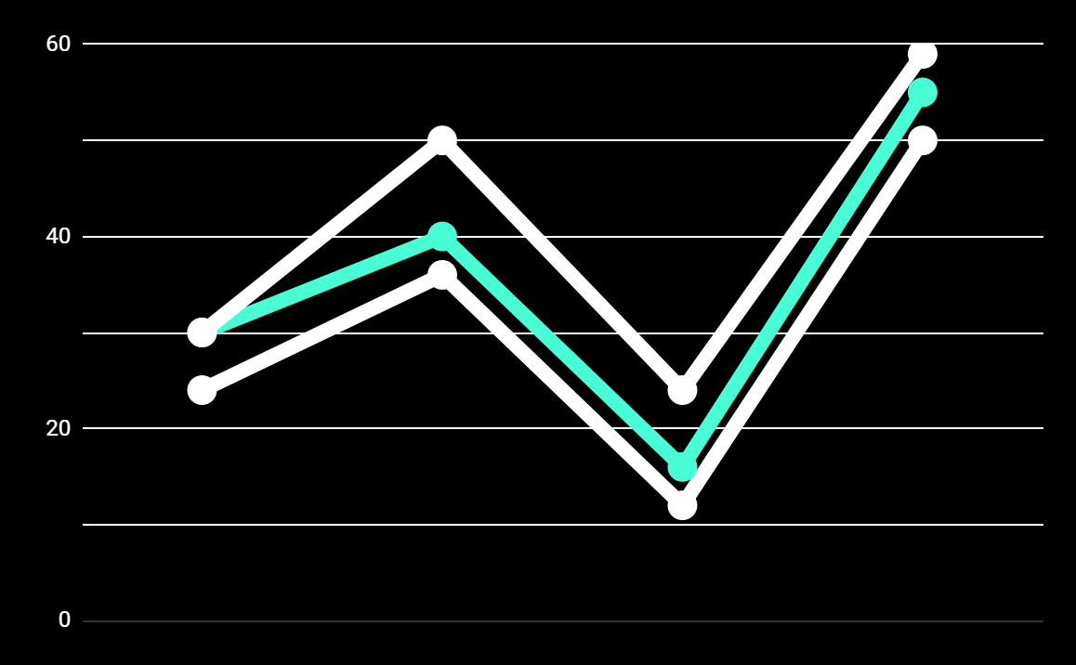
PREDICTED RESULTS
CONVERSIONS NEXT YEAR
+20%
MONTHLY VISITS
+33%
CONVERSION RATE
+40%
ANNUAL ORDERS

Slide 15
SNEAK PEEK
HEADER
TEXT
SLIDER
ICONS

Slide 16
A VIDEO IS A GOOD IDEA
Insert your multimedia content here

Slide 17
PROJECT STAGES
STEP 2
STEP 1
STEP 3
Venus has a beautiful name and is the second planet from the Sun
Despite being red, Mars is a cold place, not hot. It’s full of iron oxide dust
Saturn is a gas giant, composed mostly of hydrogen and helium

Slide 18
OUR TIMELINE
WEEK 1
WEEK 3
BETA
RELEASE
FINAL
VERSION
WEEK 2
WEEK 4
Improvements
Increased traffic
Focus group
Progress review

Slide 19
OUR PARTNERS
MARS
VENUS
MERCURY
Mercury is the closest planet to the Sun and the smallest one in our Solar System
Despite being red, Mars is a cold place, not hot. It’s full of iron oxide dust
Venus has a beautiful name and is the second planet from the Sun

Slide 20
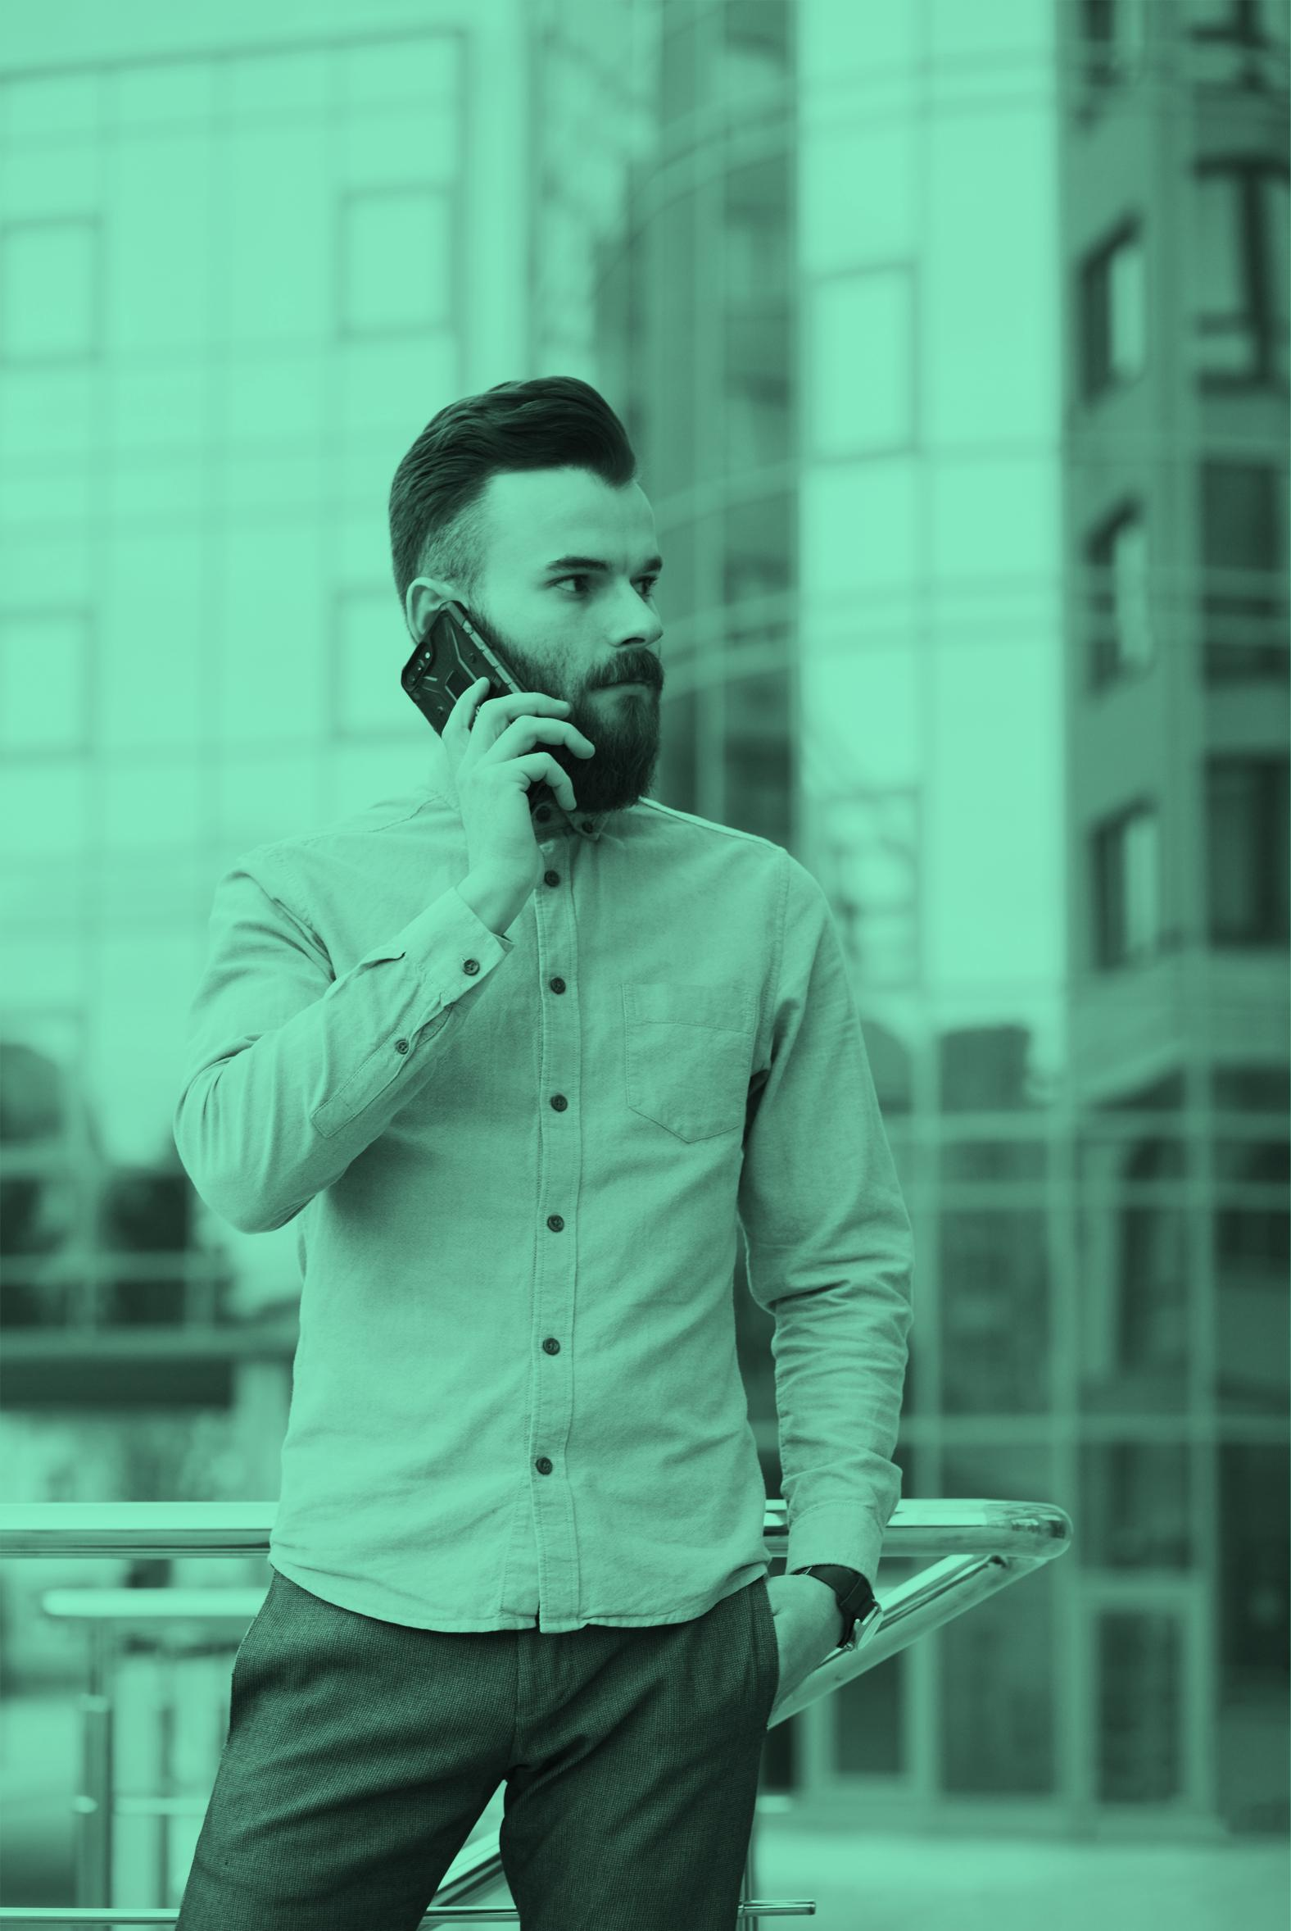
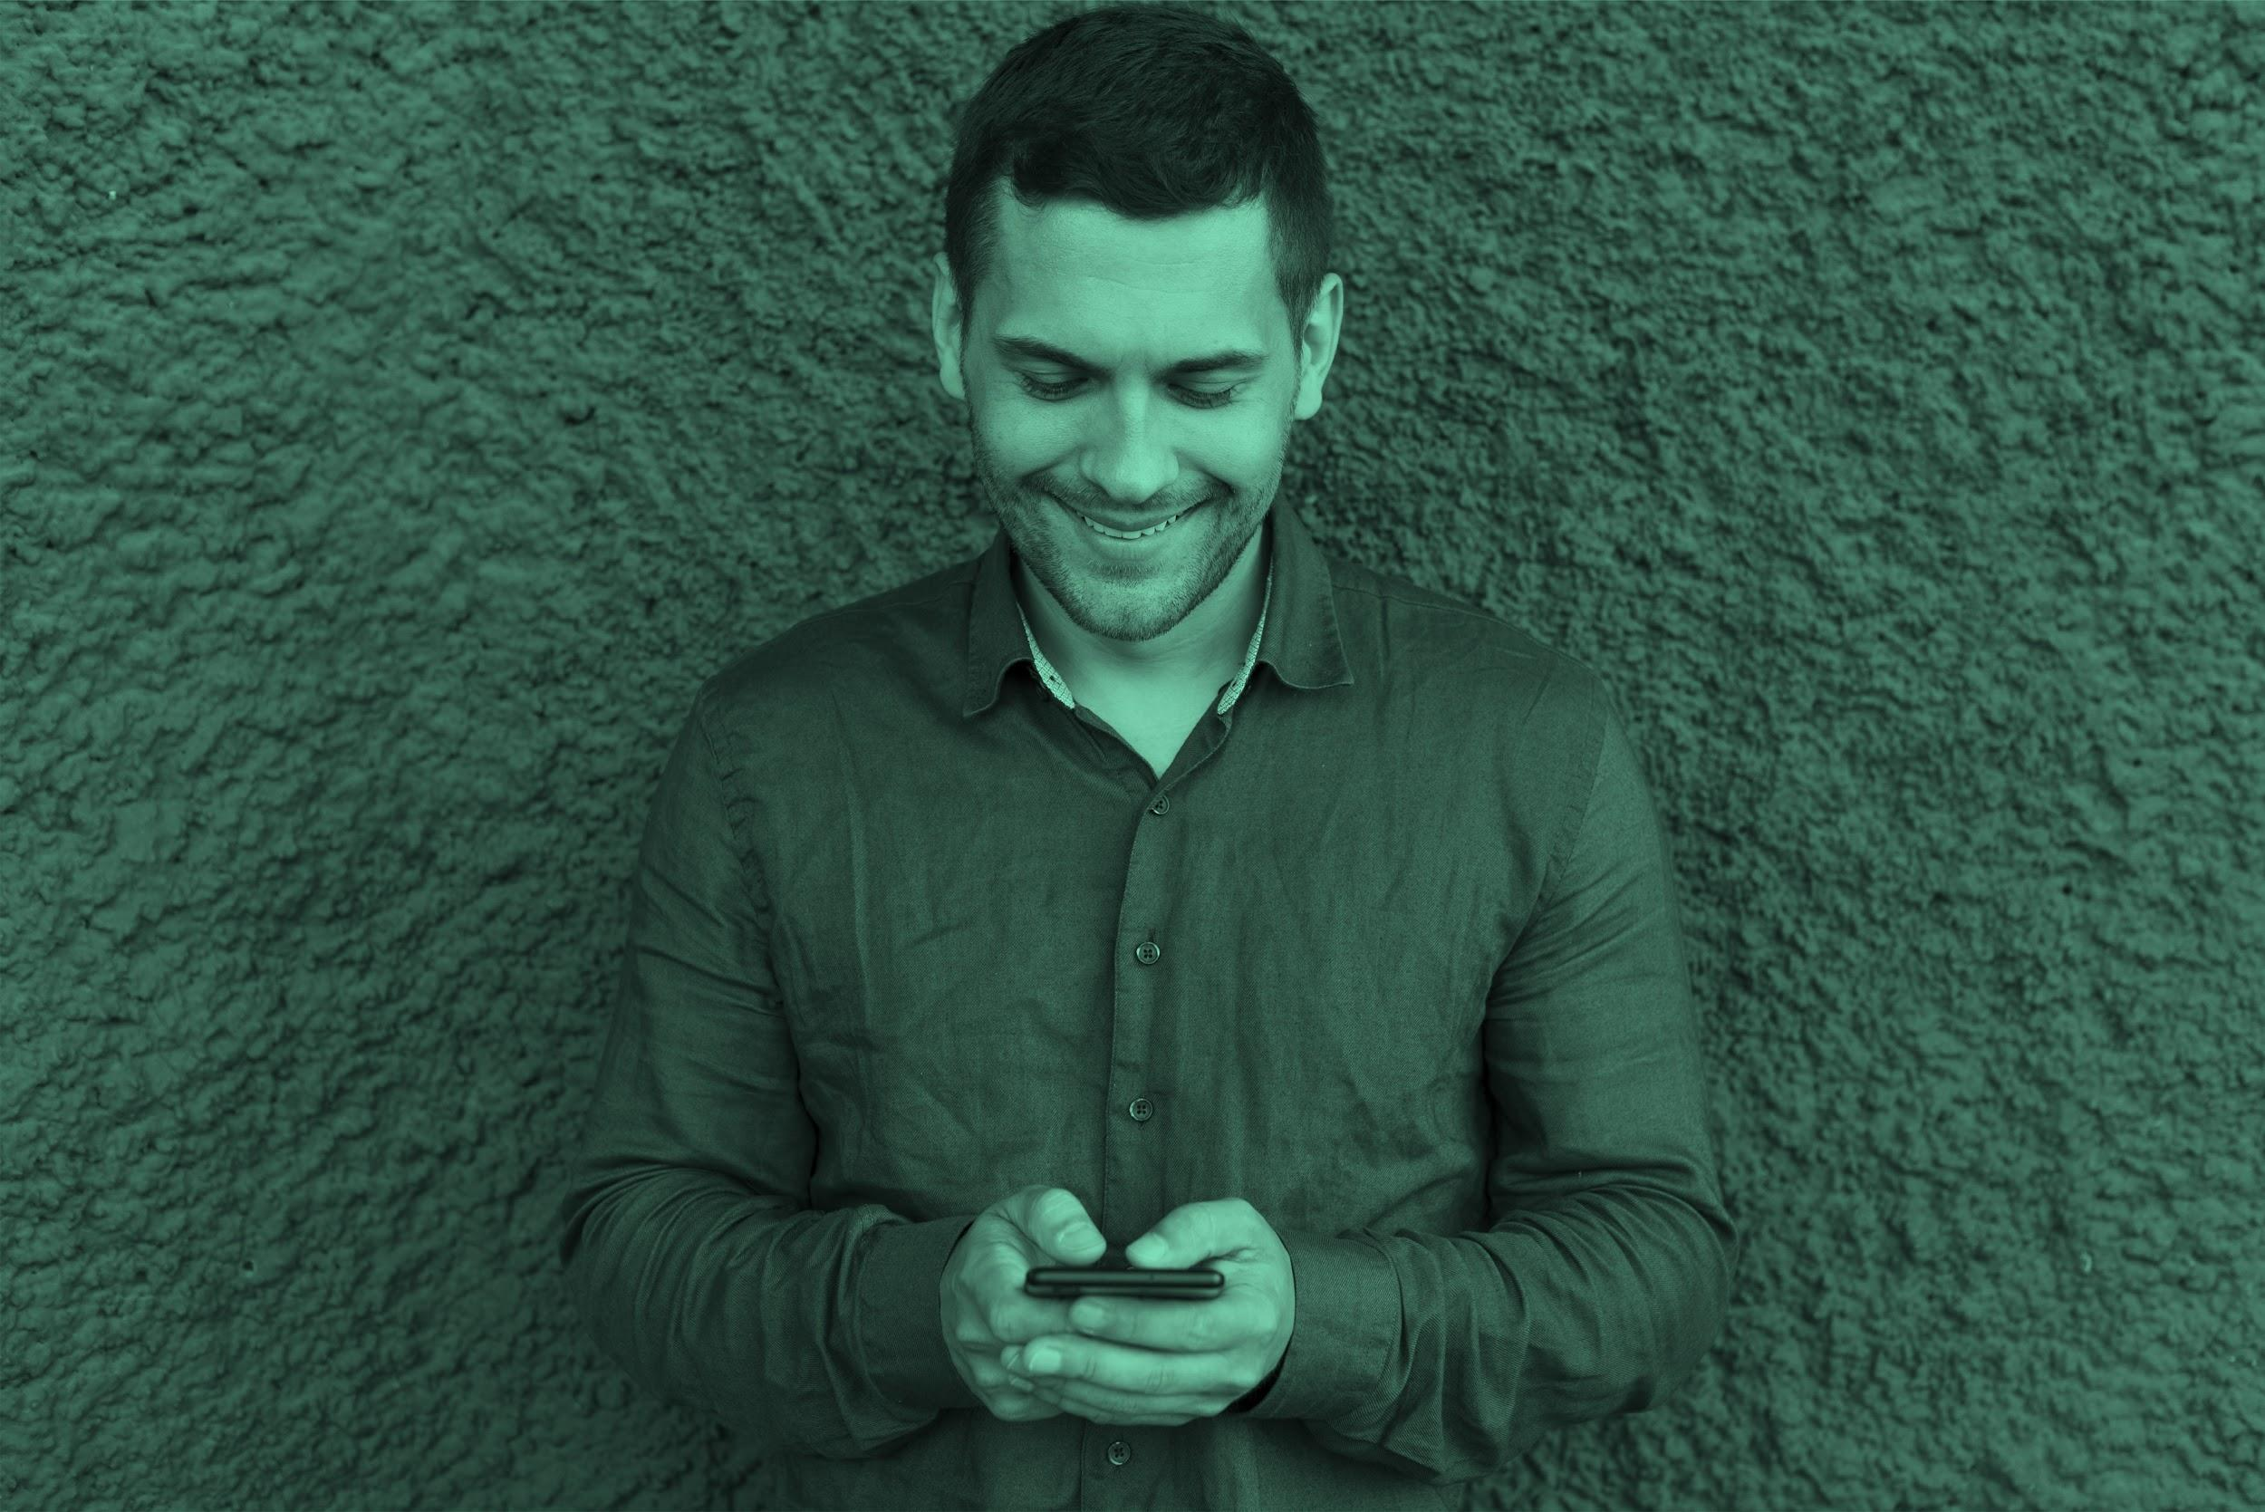

THE TEAM
JENNA DOE
JOHN DOE
JIMMY DOE
You can replace the image on the screen with your own
You can replace the image on the screen with your own
You can replace the image on the screen with your own

Slide 21
THANKS!
Does anyone have any question?
addyouremail@freepik.com
+91 620 421 838
yourcompany.com

Slide 22
CREDITS
This is where you give credit to the ones who are part of this project.
Presentation template by Slidesgo
Icons by Flaticon
Infographics by Freepik
Images created by Freepik
Author introduction slide photo created by Freepik
Text & Image slide photo created by Freepik

Slide 23
RESOURCES
Did you like the resources on this template? Get them for free at our other websites.
PHOTOS
Young businessman with hands in his pocket talking on mobile phone
Smiling ethnic woman with gray laptop
Smiling young man busy in texting message to someone
VECTORS
Flat computer engineering concept
Circuit of user experience
Timeline infographic
Logotype collection
Flat social media multimedia player templa
Gradient technology logo template collection
Digital marketing landing page template
Colorful responsive landing page
Modern web design concept with hand drawn style
App development concept with flat design

Slide 24
Fonts & colors used
This presentation has been made using the following fonts:
Roboto
(https://fonts.google.com/specimen/Roboto+bold)
Roboto
(https://fonts.google.com/specimen/Roboto+Thin)
#48ffd5
#0e2a47
#ffffff

Slide 25





Storyset
Create your Story with our illustrated concepts. Choose the style you like the most, edit its colors, pick the background and layers you want to show and bring them to life with the animator panel! It will boost your presentation. Check out How it Works.
Pana
Amico
Bro
Rafiki
Cuate

Slide 26
Use our editable graphic resources...
You can easily resize these resources without losing quality. To change the color, just ungroup the resource and click on the object you want to change. Then, click on the paint bucket and select the color you want. Group the resource again when you’re done. You can also look for more infographics on Slidesgo.

Slide 29
JANUARY
FEBRUARY
MARCH
APRIL
MAY
JUNE
PHASE 1
Task 1
Task 2
PHASE 2
Task 1
Task 2
JANUARY
FEBRUARY
MARCH
APRIL
PHASE 1
Task 1
Task 2

Slide 32
Educational Icons
Medical Icons

Slide 33
Business Icons
Teamwork Icons

Slide 34
Help & Support Icons
Avatar Icons

Slide 35
Creative Process Icons
Performing Arts Icons

Slide 36
Nature Icons

Slide 37
SEO & Marketing Icons

Slide 38


